Slide 1
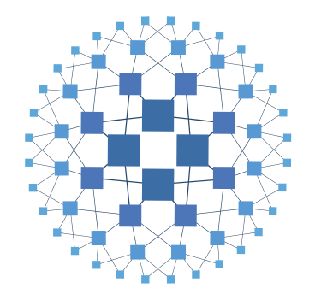

Scaling WebSockets
With HAProxy, Pub - Sub and Distributed Caches

Slide 2


Introduction

Slide 3
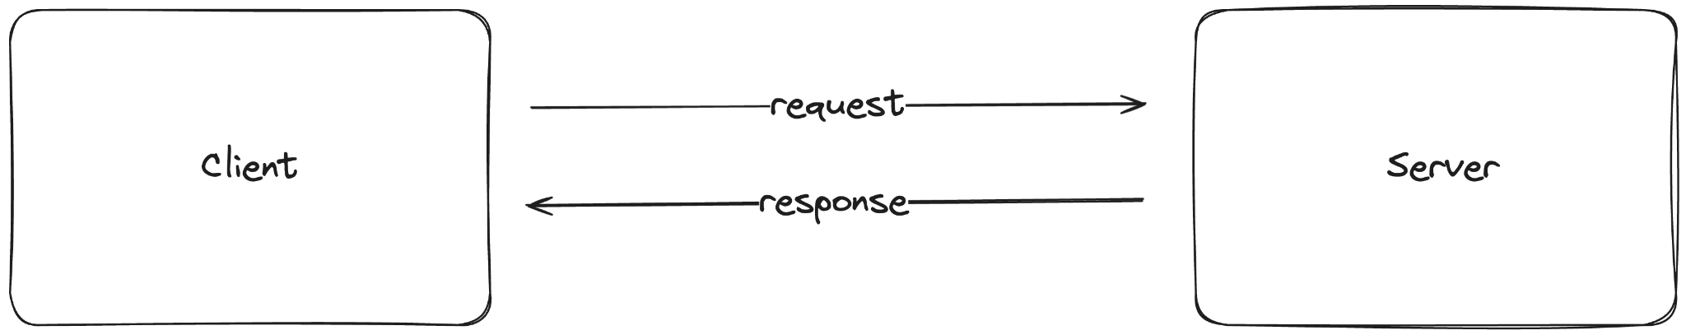
Exchanging information over the WWW
Client - Server architecture

Slide 4
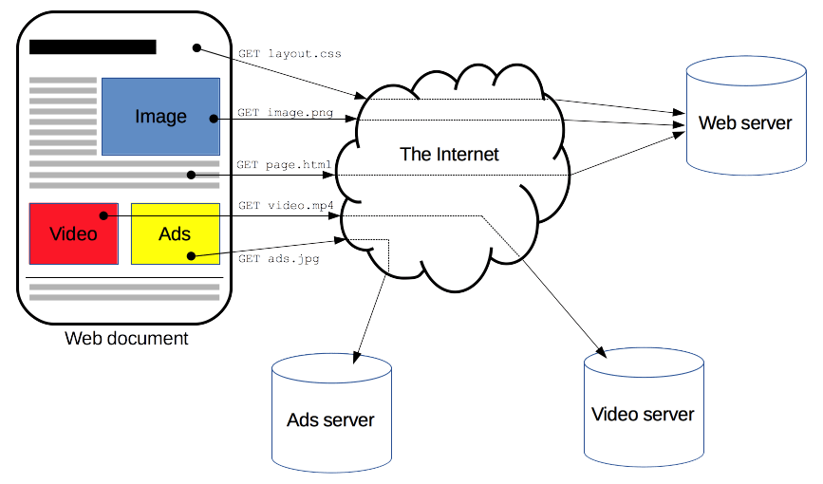
Communication happens over HTTP
https://developer.mozilla.org/en-US/docs/Web/HTTP/Overview

Slide 5
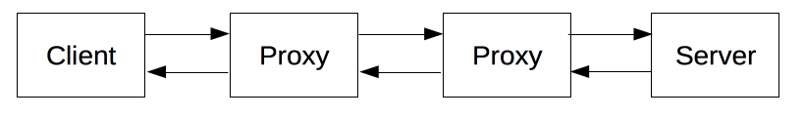
Hypertext Transfer Protocol
https://developer.mozilla.org/en-US/docs/Web/HTTP/Overview
It is a stateless protocol
Uses TCP as the transport layer protocol

Slide 6
HTTP Protocol
TCP Connection Establishment in HTTP
Before HTTP communication begins, a TCP connection must be established, requiring several round-trips
HTTP/1.0 defaults to opening separate TCP connections for each request/response pair, which can be inefficient

Slide 7
HTTP Protocol
Improvements in HTTP/1.1
HTTP/1.1 introduced pipelining and persistent connections to optimize TCP usage, although pipelining proved challenging

Slide 8
Demonstration

Slide 9
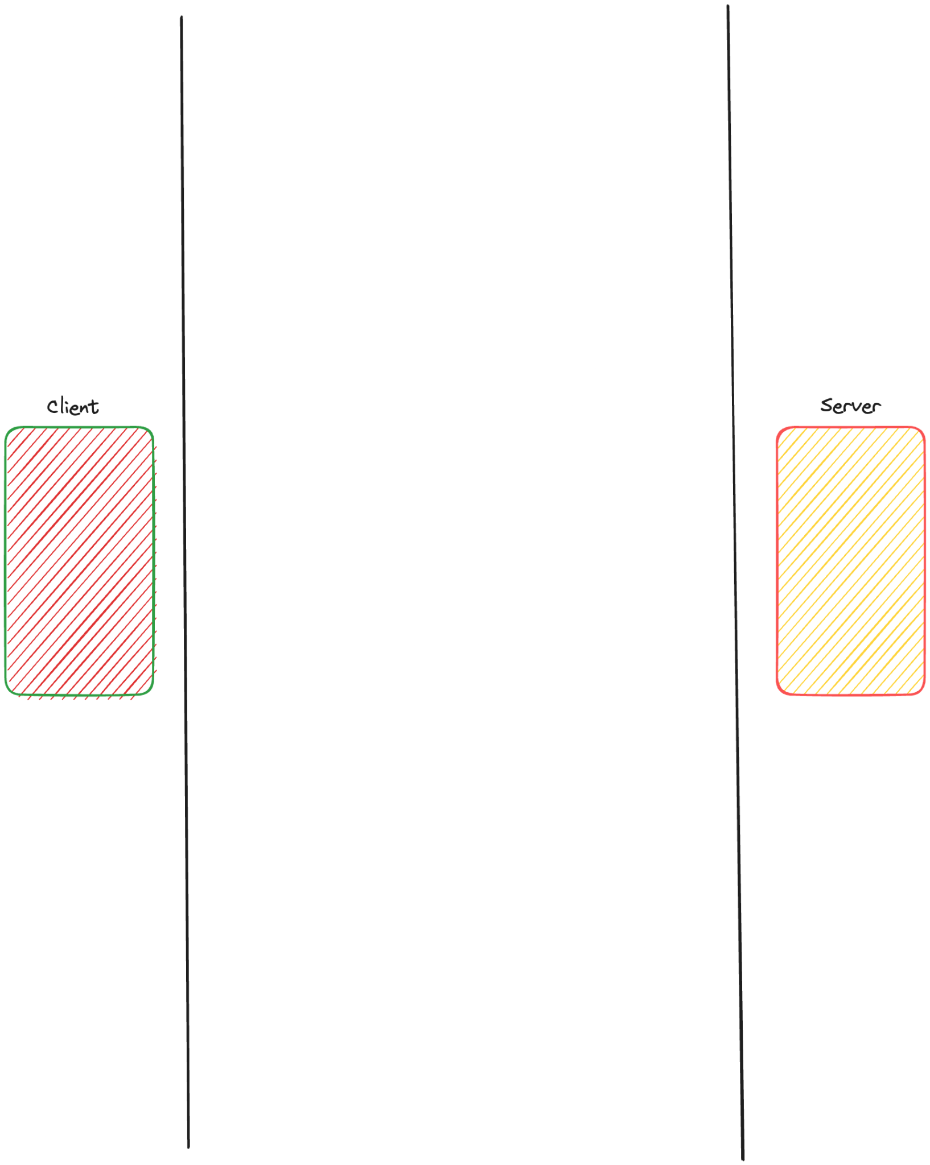

Slide 10
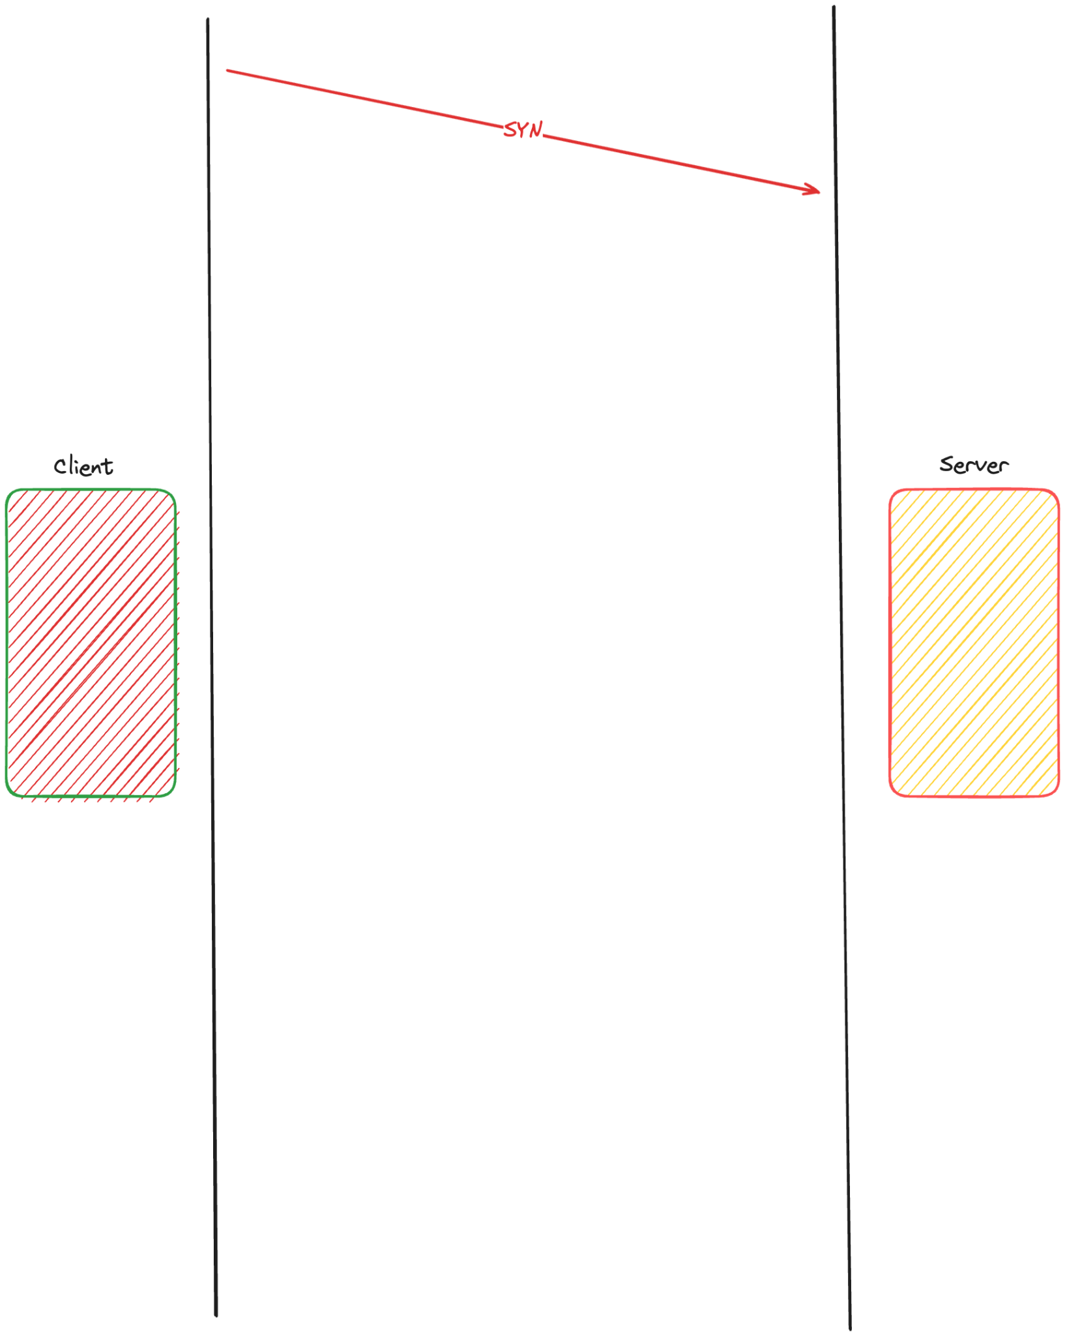

Slide 11
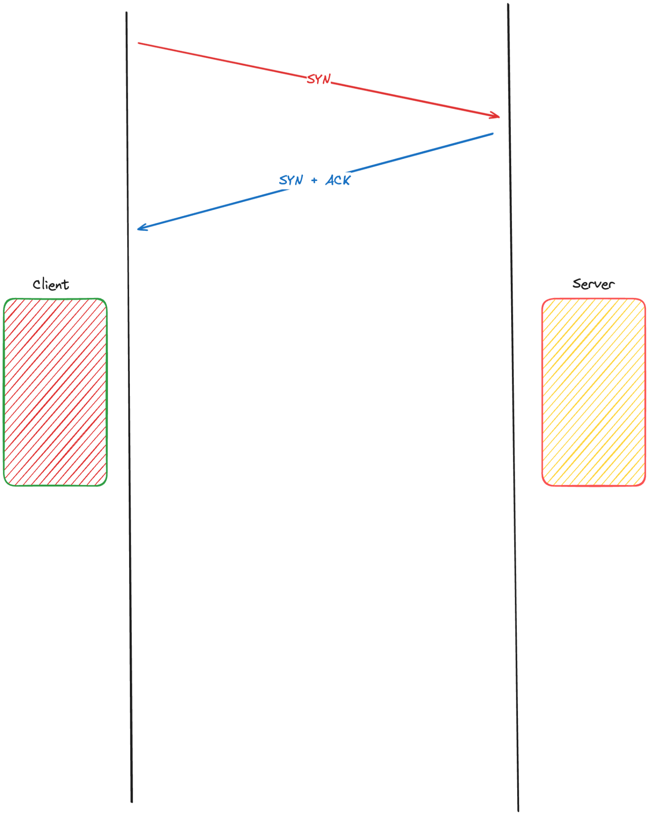

Slide 12
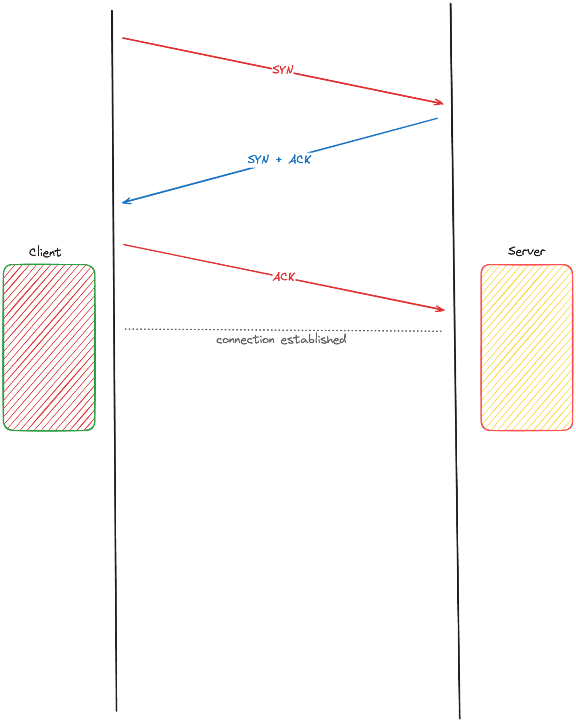

Slide 13
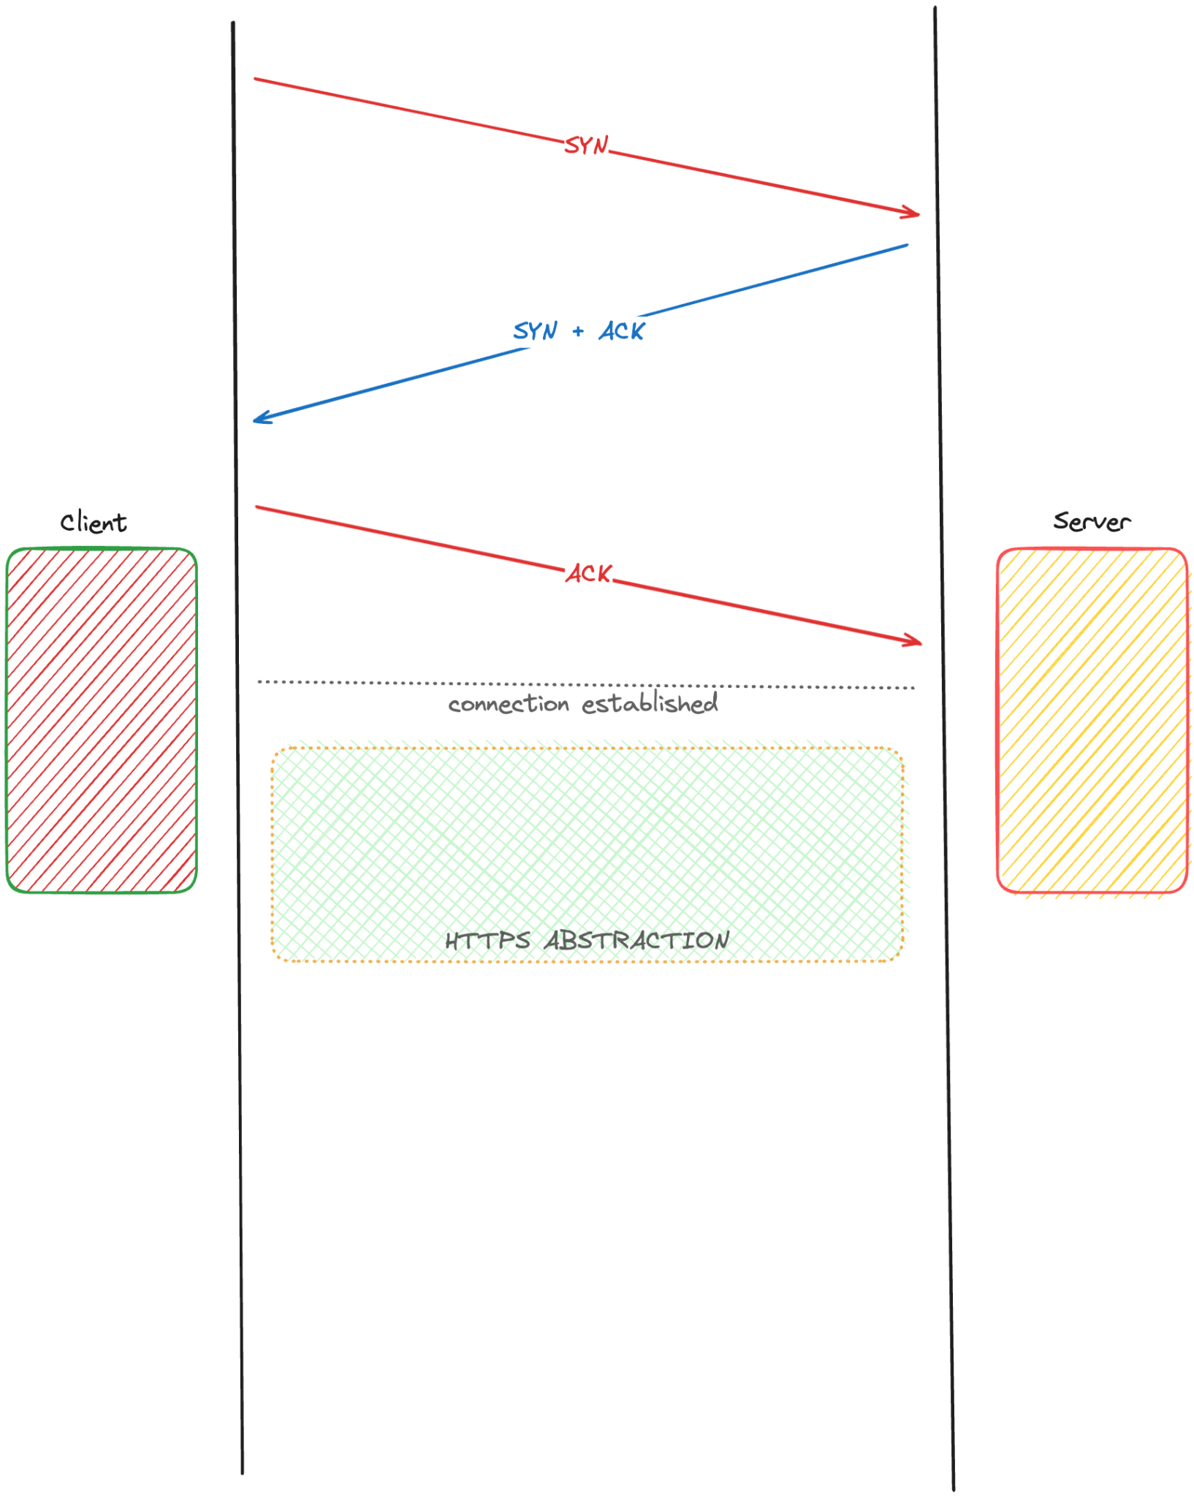

Slide 14
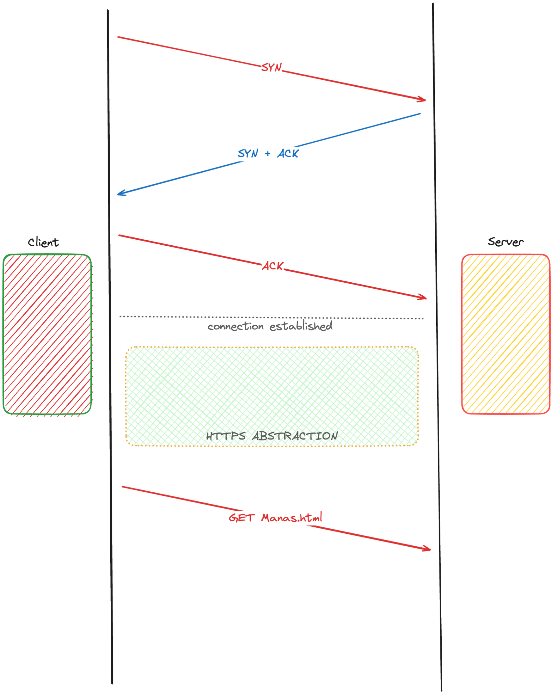

Slide 15
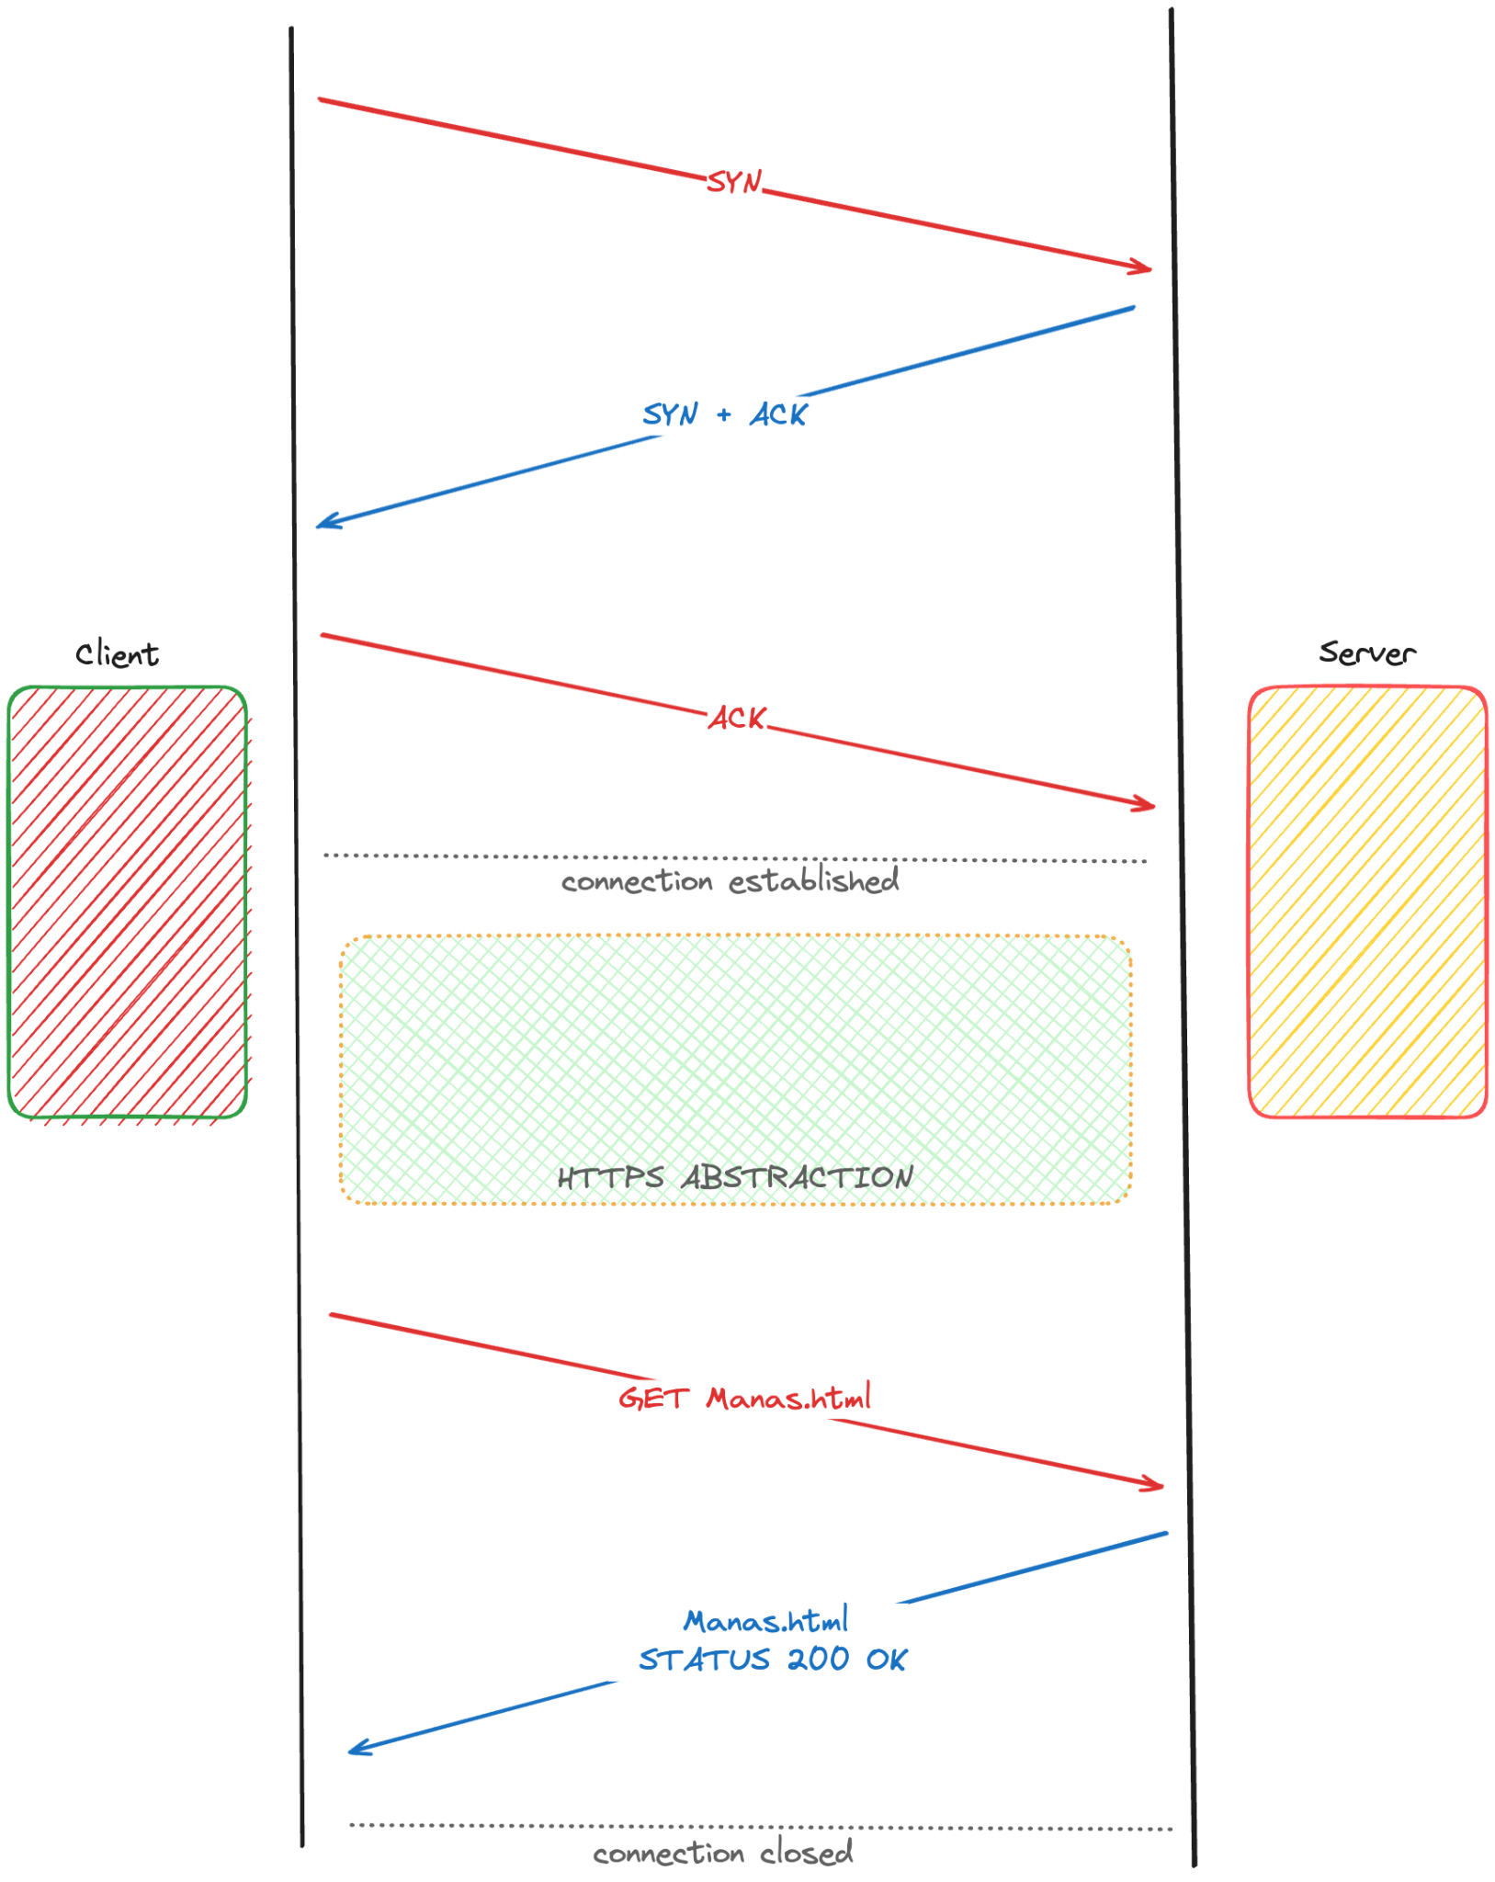

Slide 16
Hypertext Transfer Protocol
https://developer.mozilla.org/en-US/docs/Web/HTTP/Overview
The browser is always the entity initiating the request. It is never the server that sends a response automatically
The connection is cut-off after a request-response pair

Slide 17
How to achieve a stateful connection ?
WebSocket Protocol

Slide 18
Why WebSocket Protocol ?
Full-duplex, bi-directional communication
Persistent Stateful Connection
Server can send resources even without client initiating a request

Slide 19
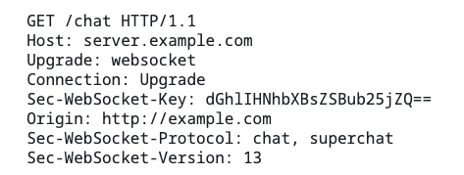
WebSocket Protocol
Initial GET request over a HTTP /1.1 with an upgrade flag

Slide 20
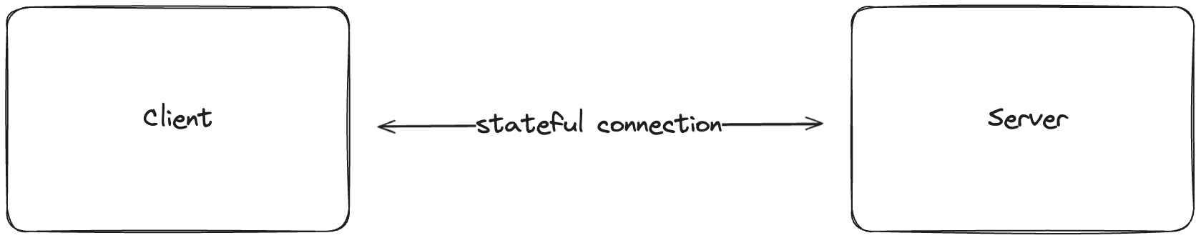
WebSocket Protocol

Slide 21
Proof of Work

Slide 22
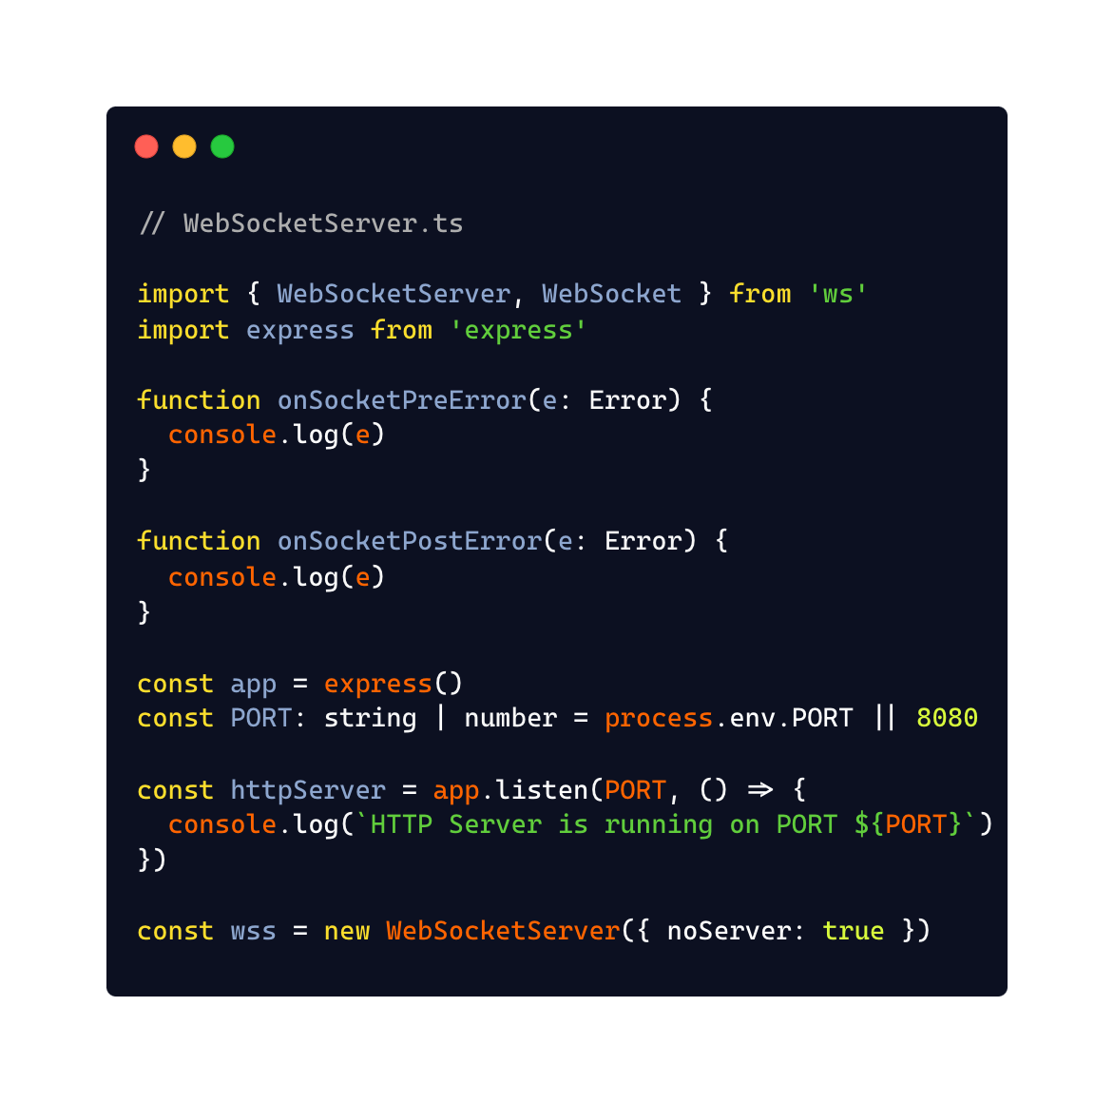
https://github.com/akarmanya/wscale

Slide 23
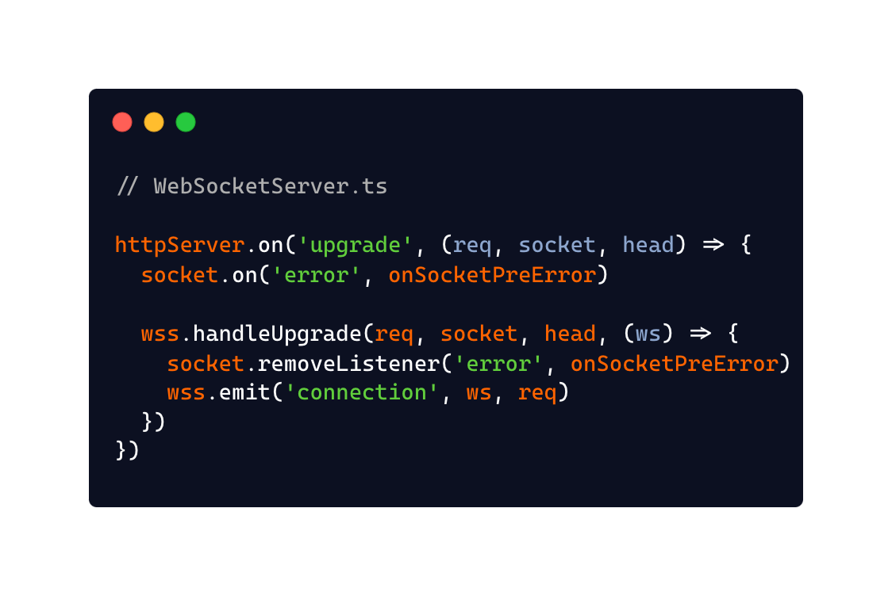
https://github.com/akarmanya/wscale

Slide 24
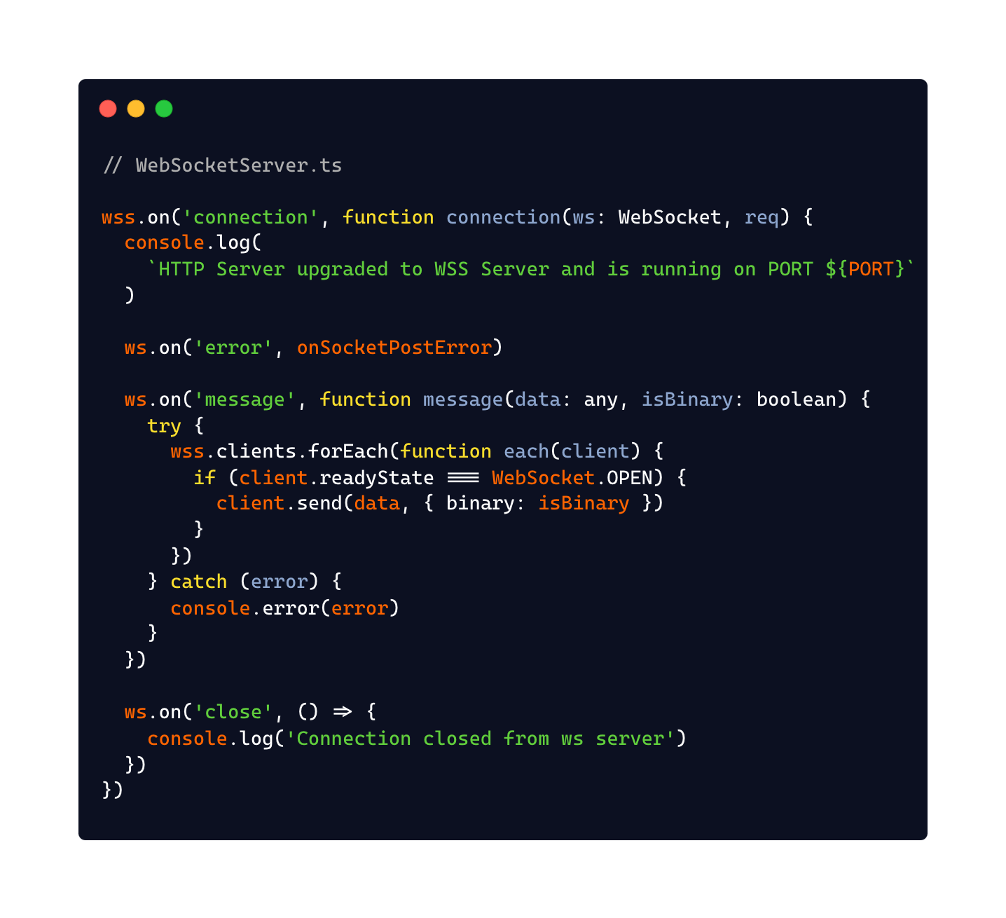
https://github.com/akarmanya/wscale

Slide 25
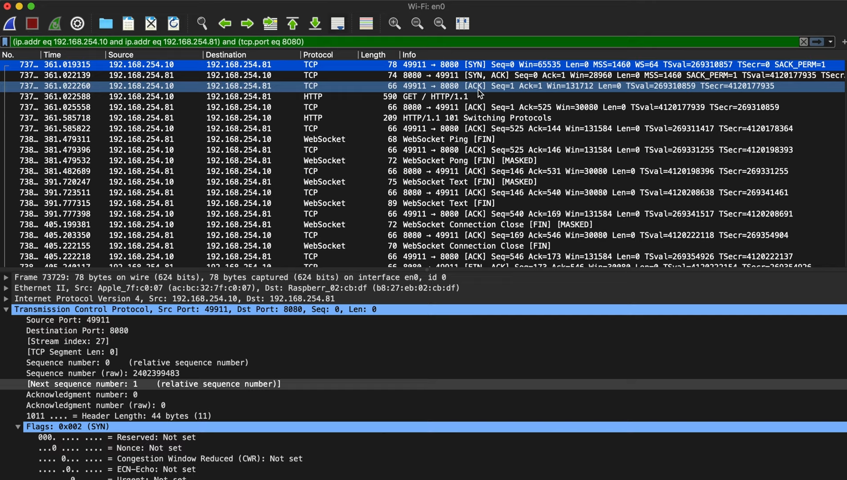

Slide 26
Why WebSockets are difficult to scale
HTTP works on a duplex communication model
The client initiates a request to the server for a resource
The server responds back with a response
Once the client receives the response, the connection is closed

Slide 27
Demonstration

Slide 28
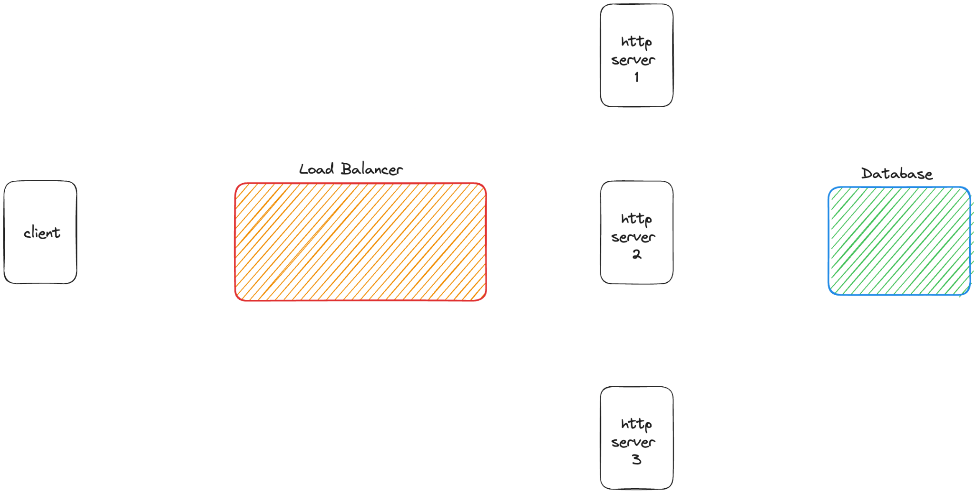

Slide 29
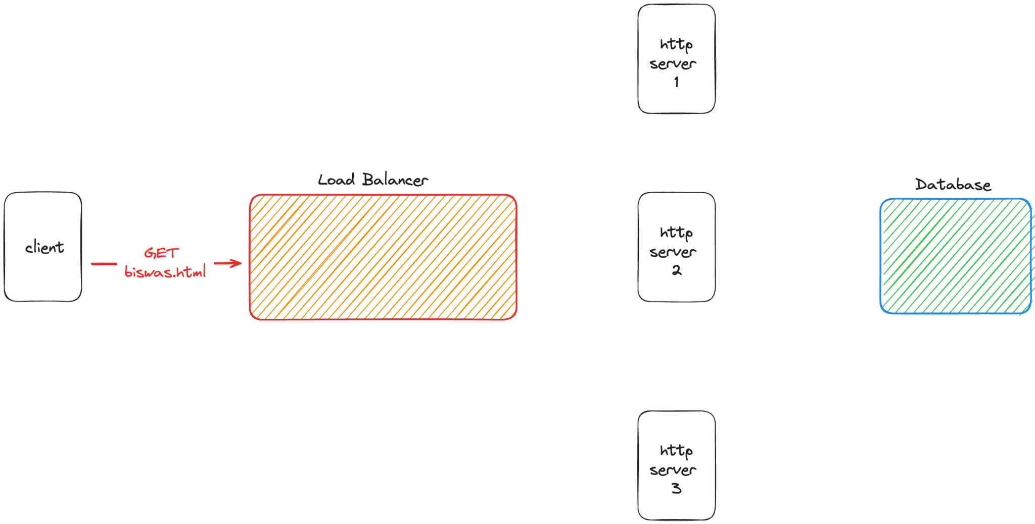

Slide 30
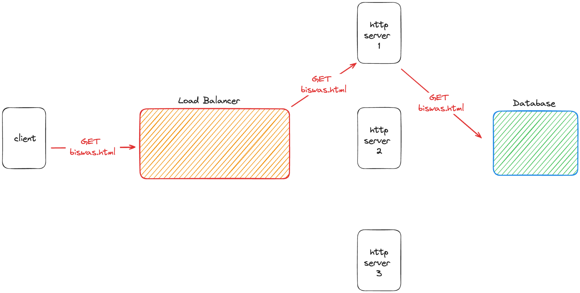

Slide 31
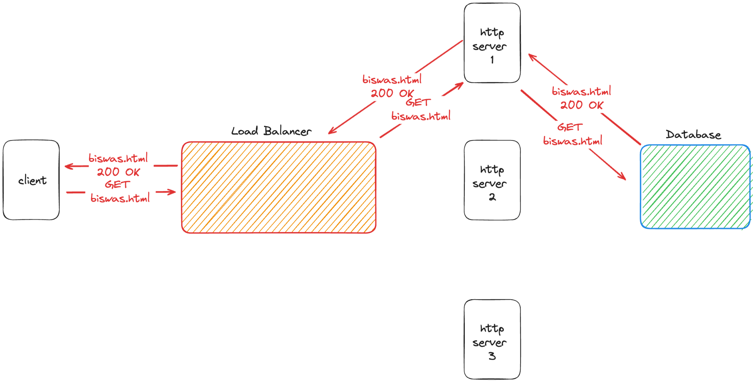

Slide 33
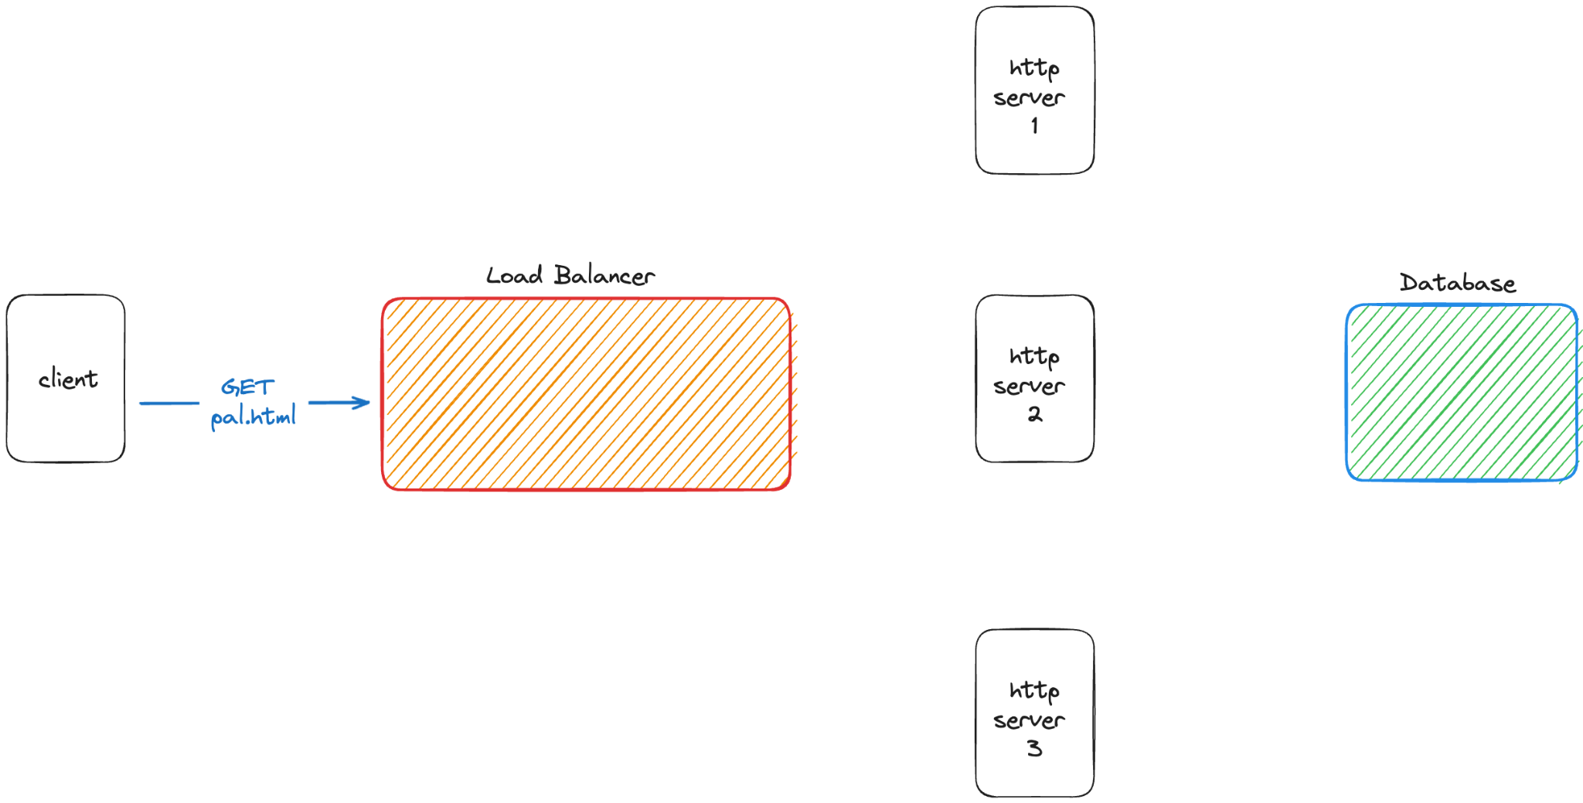

Slide 34
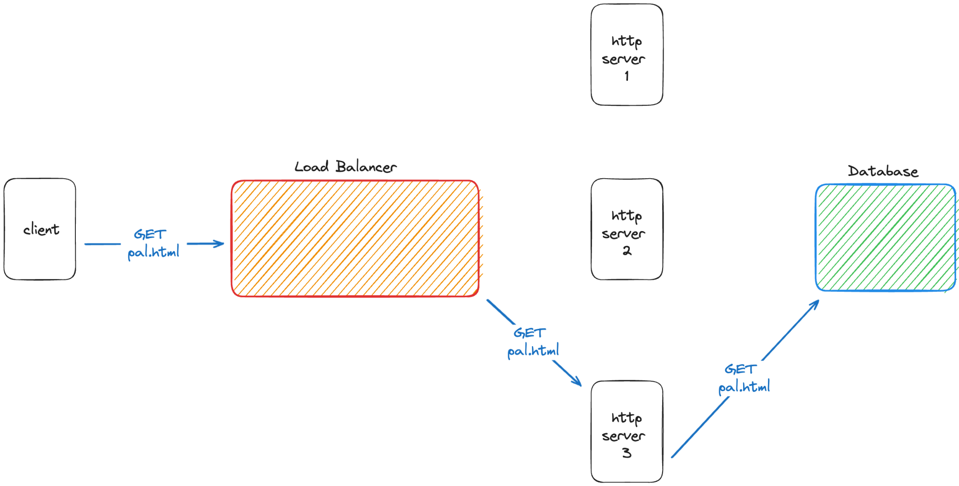

Slide 35
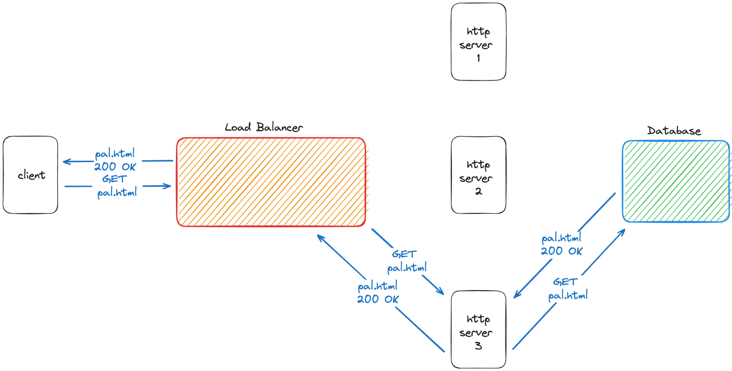

Slide 37
Why WebSockets are difficult to scale
Hence, one client can request to multiple HTTP servers and the client state need not be stored
Millions of clients can be served independently across multiple HTTP servers
Therefore, HTTP servers are horizontally scalable

Slide 38
Why WebSockets are difficult to scale
However, in case of WebSocket connection, one client is binded to a single WebSocket server
Loss of connection implies loss of state
Therefore, one client ideally binds to one WebSocket server and scaling horizontally cannot replicate states
across the servers

Slide 39
How to achieve a synchronised stateful connection ?
Load Balancer
Publisher - Subscriber

Slide 40
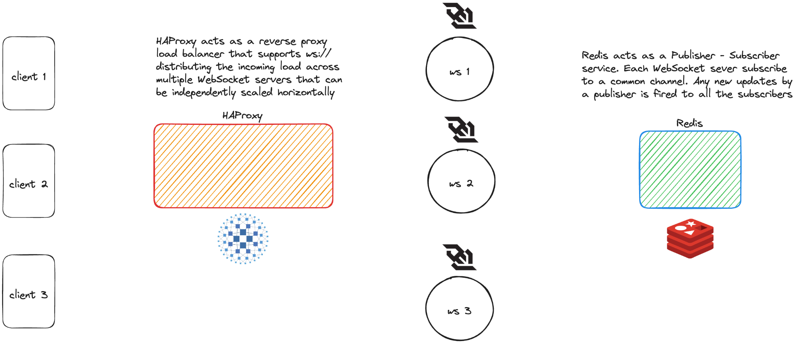
The Architecture

Slide 41
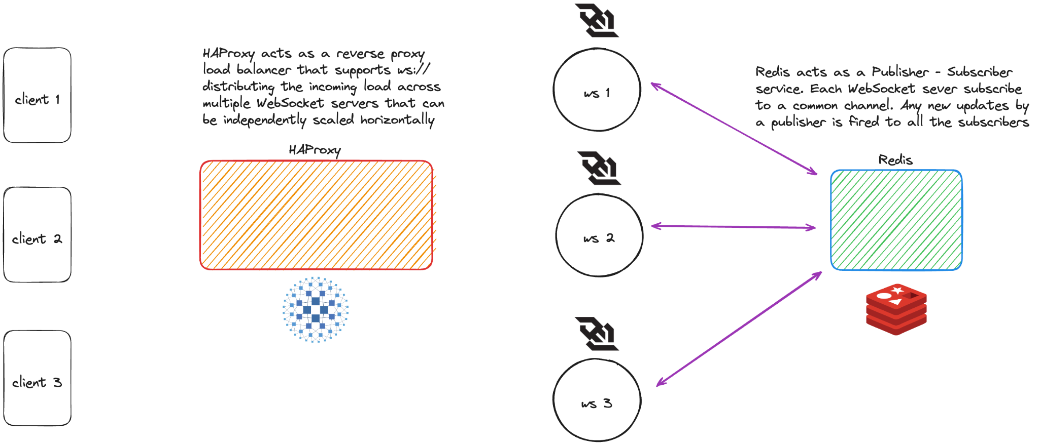
The Architecture

Slide 42
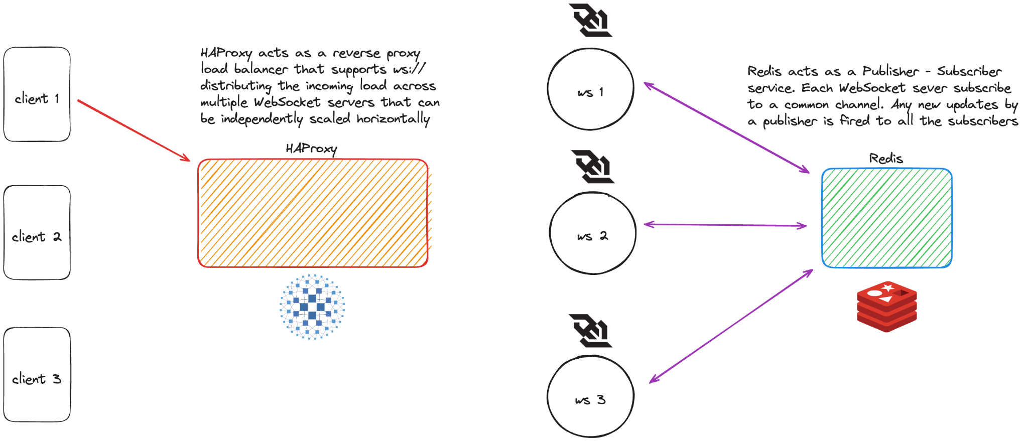
The Architecture

Slide 43
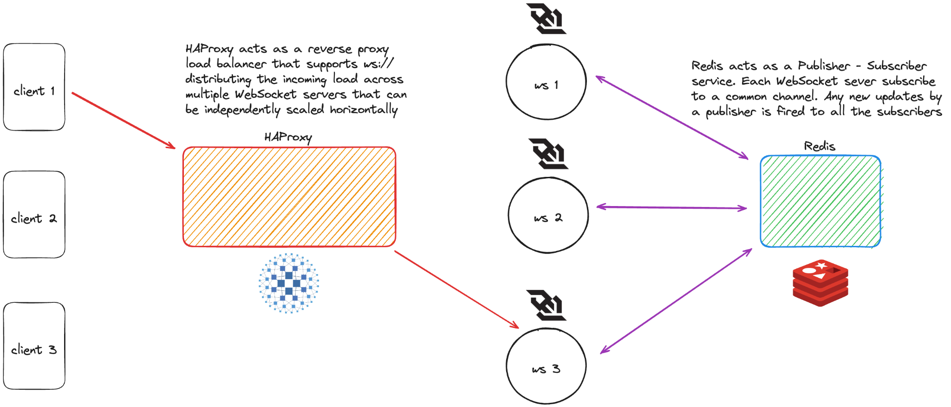
The Architecture

Slide 44
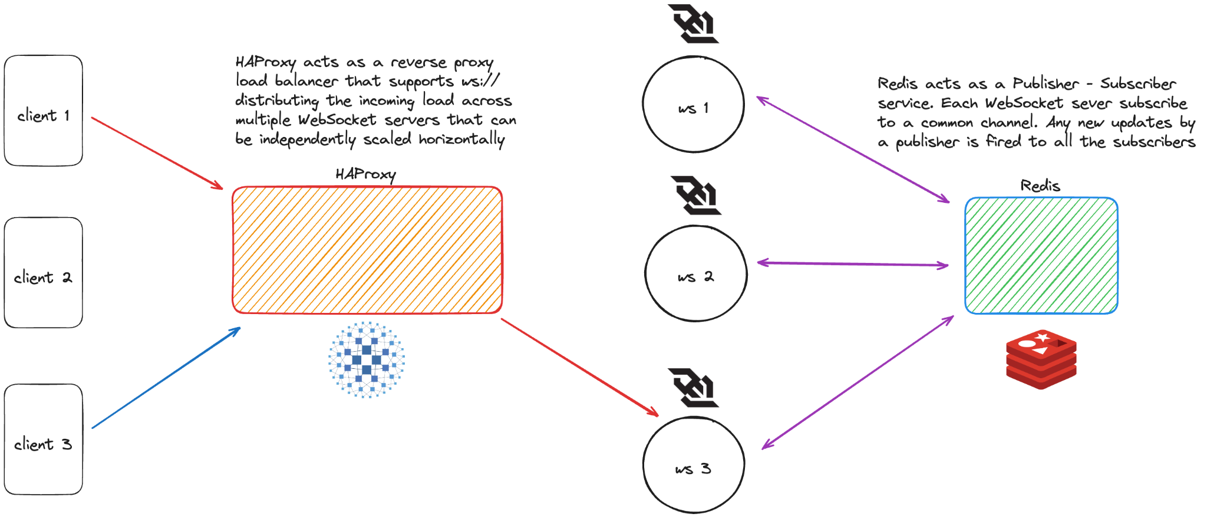
The Architecture

Slide 45
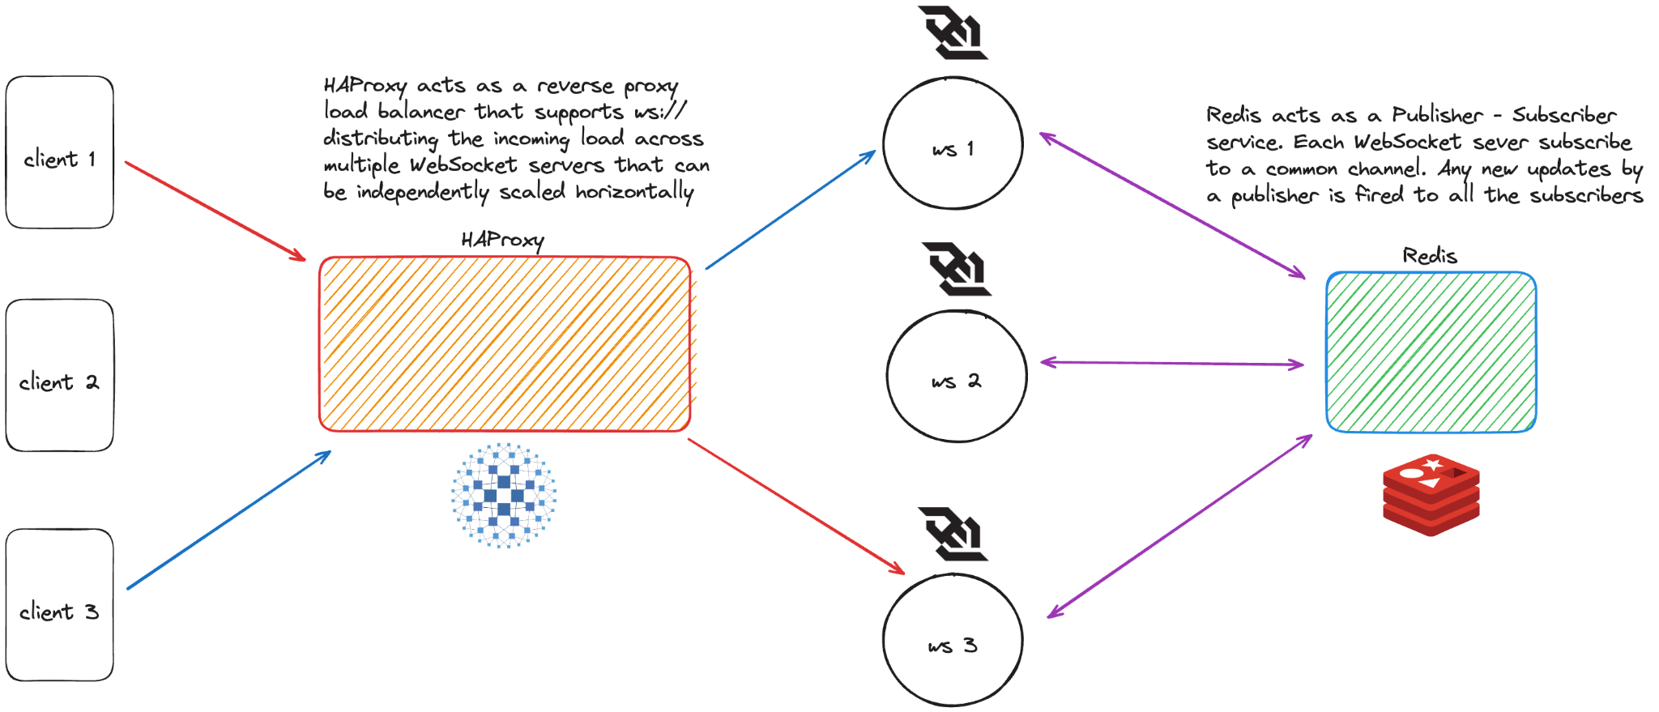
The Architecture

Slide 46
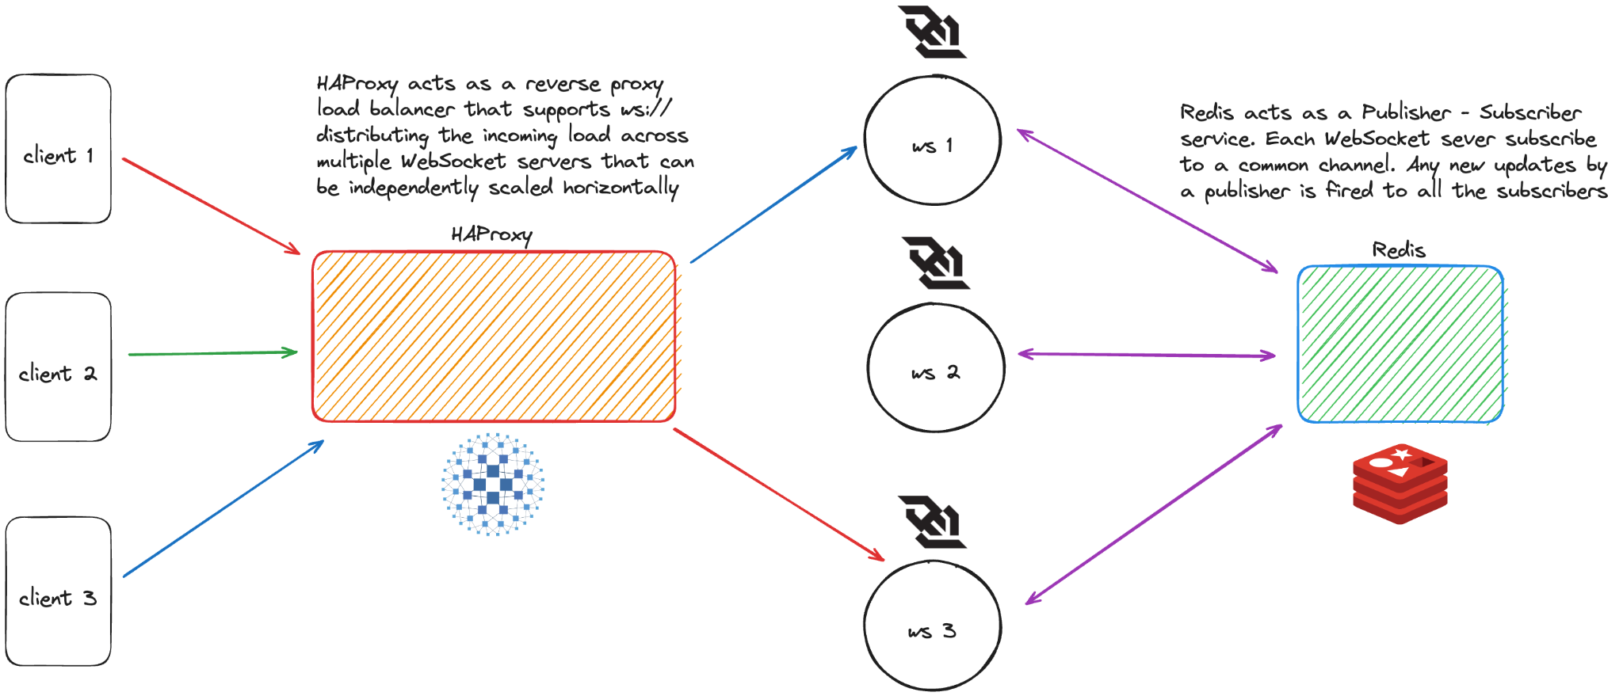
The Architecture

Slide 47

The Architecture

Slide 48

The Architecture

Slide 49

The Architecture

Slide 50

The Architecture

Slide 51

The Architecture

Slide 52

The Architecture

Slide 53

The Architecture

Slide 54
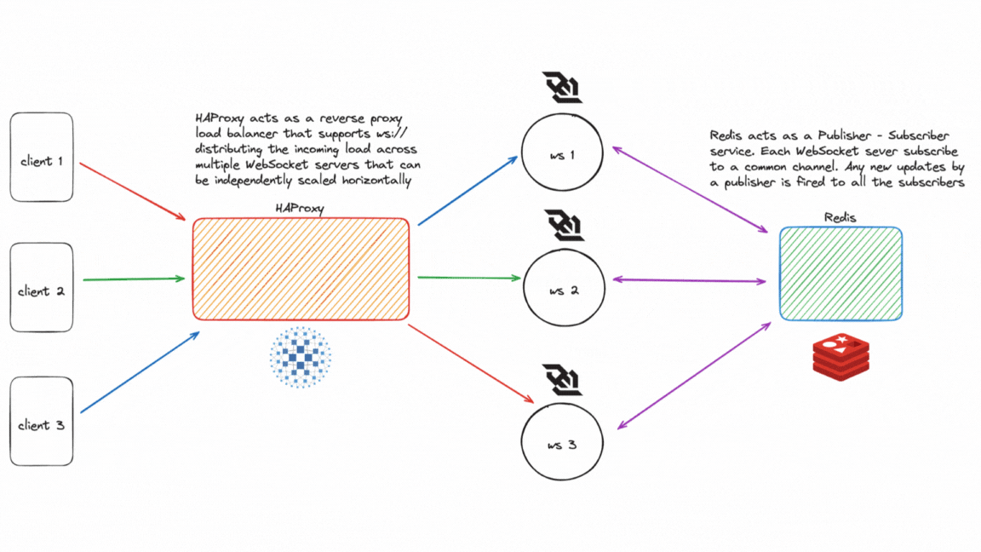
The Architecture
The Architecture

Slide 55
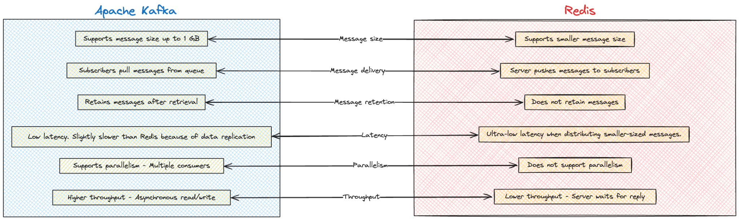
Redis v/s Kafka
(Deciding which Pub-Sub to use to when ?)
https://aws.amazon.com/compare/the-difference-between-kafka-and-redis/

Slide 56
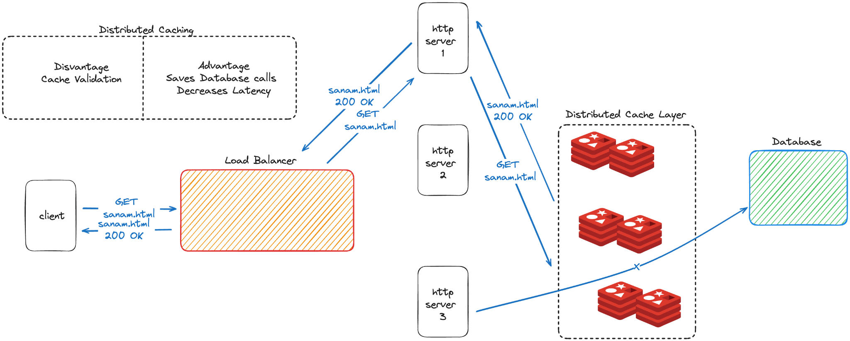
Distributed Caching
https://redis.io/glossary/distributed-caching/

Slide 57
Conclusion

Slide 58
Conclusions
- A single WebSocket connection is blocking in nature and highly resource intensive
- WebSocket cannot be scaled vertically due to hardware limitations
- Horizontal scaling is only possible across multiple WebSockets if the incoming load can be balanced to multiple servers using a Reverse Proxy and all of them maintain a common state through a Pub-Sub mechanism

Slide 59
Limitation

Slide 60
Limitations
- Maintaining a common state across all the WebSockets is hard to implement
- In case of frequent state updates and concurrent access to shared resources may lead to race conditions
- Employing synchronization mechanisms such as mutexes, semaphores, or atomic operations to coordinate access to shared resources need to be employed when dealing with distributed systems leading to higher latency

Slide 61
References
https://github.com/hnasr/javascript_playground/
tree/master/ws-live-chat-system
https://datatracker.ietf.org/doc/html/rfc6455
https://www.haproxy.org
https://redis.io/docs/latest/develop/interact/
pubsub

Slide 62
Thank you
https://github.com/akarmanya/wscale
Manas Pratim Biswas (@sanam2405)
Roll - 002011001025 UG - IV
Information Technology
Jadavpur University

Slide 63
Questions ?

